Slide 1
GitHub 101 Using Github and Git for Source Control
Patrick Flynn | Link Group Australia

Slide 2

















A big thanks to all of our sponsors!

Slide 3




Patrick Flynn SQL Server DBA Link Group
MCM – SQL Server 2008
MCSM – Data Platform
Production DBA for 10+ years.
https://github.com/sqllensman/Presentations
sqlsaturday@sqllensman.com
@sqllensman
Patrick Flynn
#746 | Oslo 2018

Slide 4
Agenda:
What is Git and GitHub?
Why would you care?
Basic Commands
Demo

Slide 5

What is it?
Notes:
"Hello, Git! I hate you already!“
Most of us dislike Git on the first try even after running the most basic Git commands. Having a Git cheat sheet taped to our table doesn't help. Git is very complicated, as you can't learn all its concepts by just using it.
To make Git our best friend, we should understand how Git works. To do so, we should also start using basic Git commands.
What's Git?
Git is a distributed version control system (DVCS). "Distributed" means that all developers within a team have a complete version of the project. A version control system is simply software that lets you effectively manage application versions. Thanks to Git, you'll be able to do the following:
Keep track of all files in a project
Record any changes to project files
Restore previous versions of files
Compare and analyze code
Merge code from different computers and different team members.

Slide 6
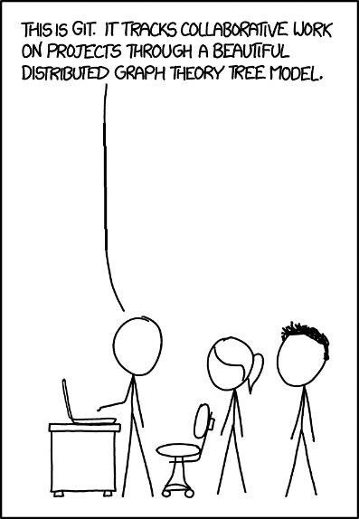
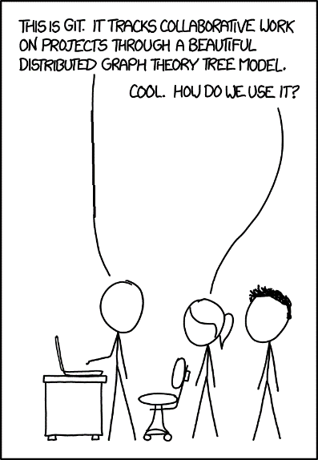
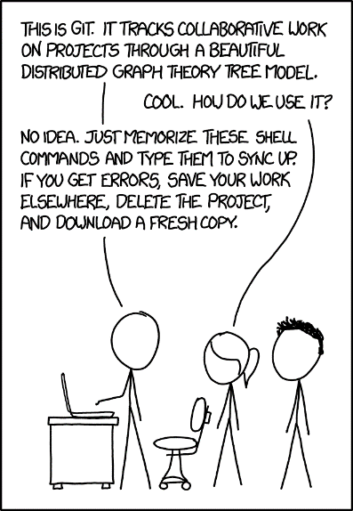
Notes:
It’s the worst source control system! (except for all the others).

Slide 7

branch
checkout
add
commit
pull
push
(plus a few more)
Notes:
It’s the worst source control system! (except for all the others).

Slide 8
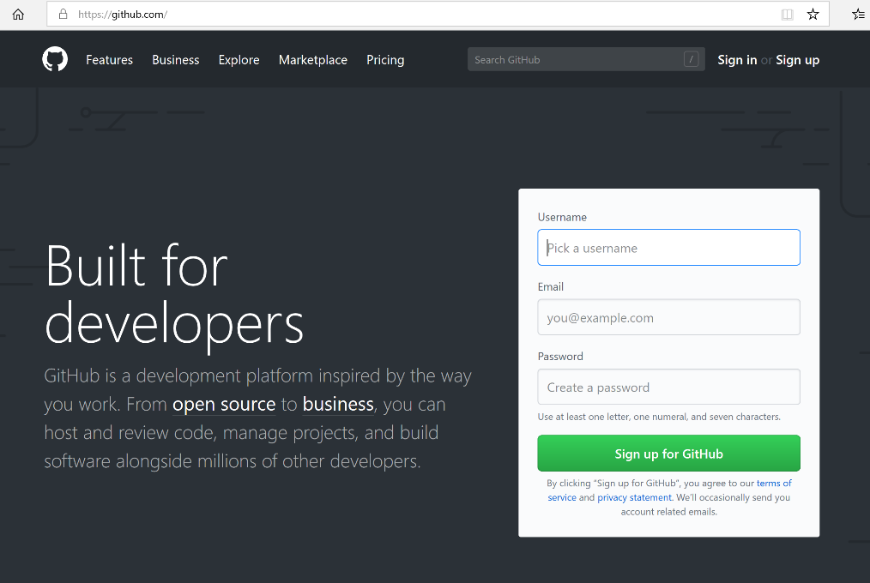
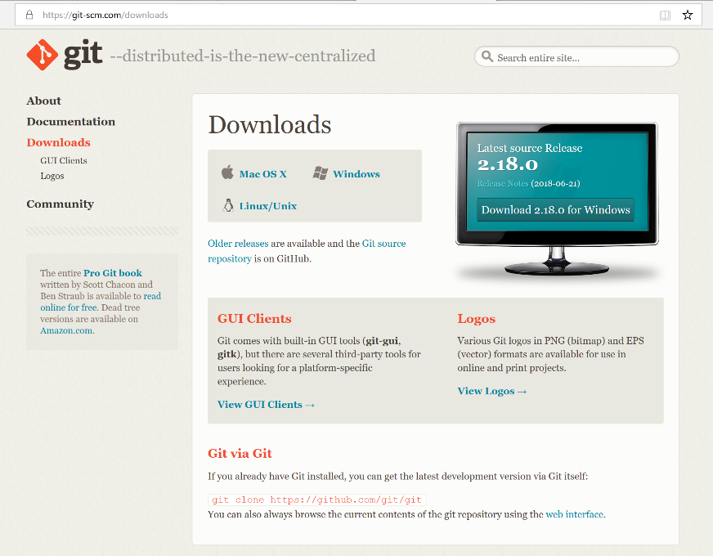
Setup:
Install Git
Sign up for Online Account (Github)
Install GitHub Desktop (optional)
Notes:
Can use

Slide 9
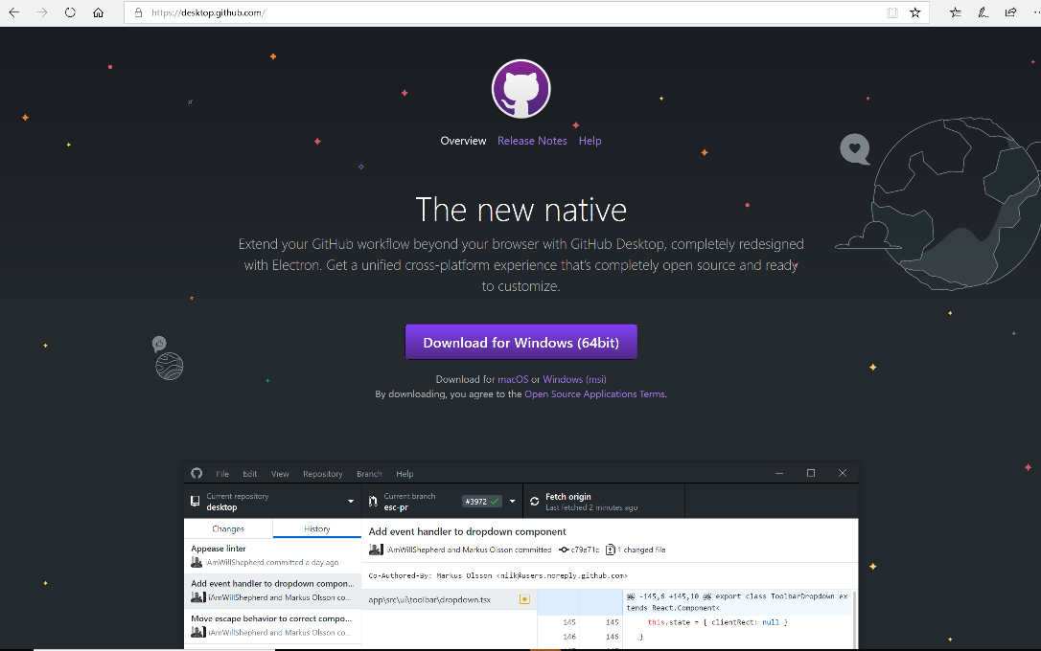

Slide 10
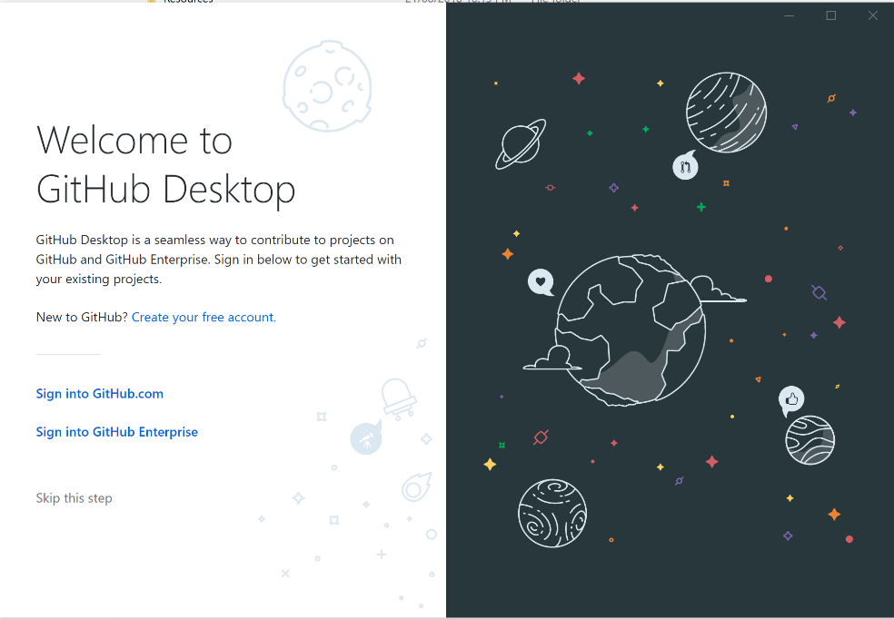

Slide 11
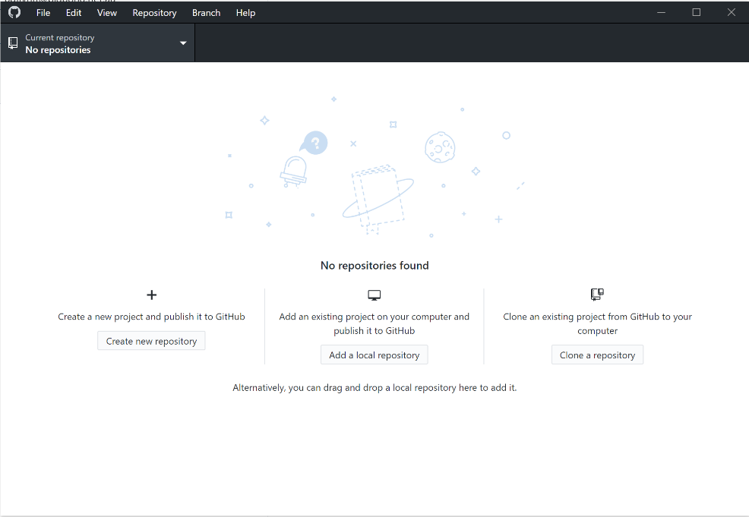

Slide 12
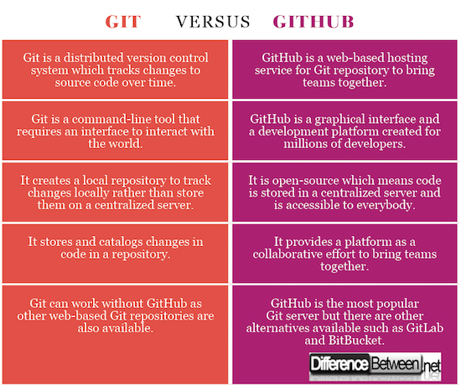
www.differencebetween.net/technology/difference-between-git-and-github/

Slide 13
Workflow

Slide 14
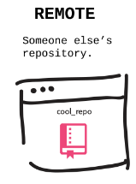
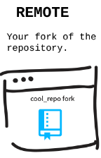

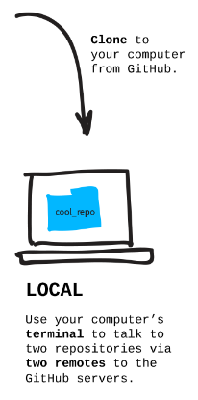

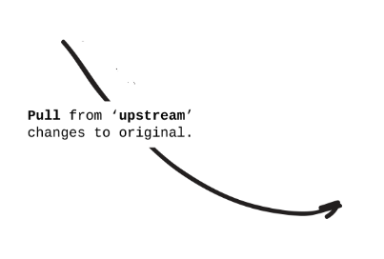
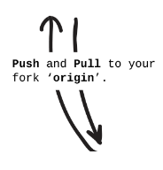
BRANCH
CHECKOUT
ADD
COMMIT

Slide 15
Fork

Slide 16
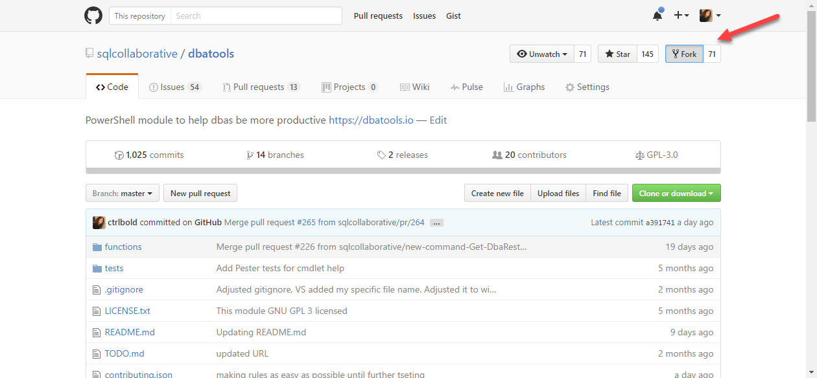
Make a fork of the dbatools repository
Notes:
Because you don't have write permissions to the repository, you'll have to fork it to your own repo, and do your commits there.

Slide 17
Clone
Notes:
Cloning a repository is very different from pulling from a repository. If you clone a remote repository, Git will:
Download the entire project into a specified directory; and
Create a remote repository called origin and point it to the URL you pass.

Slide 18
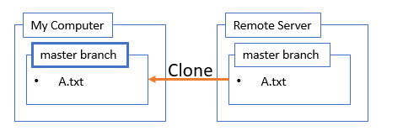
Clone a Repository
git clone https://github.com/SQLLensman/dbatools.git
Source: Michael Swart (http://michaeljswart.com/)

Slide 20
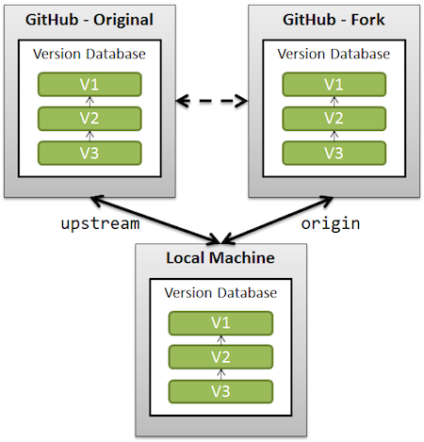
Configure Upstream remote
git remote add upstream https://github.com/sqlcollaborative/dbatools.git
Added automatically
Most be added manually

Slide 21
Branch

Slide 22
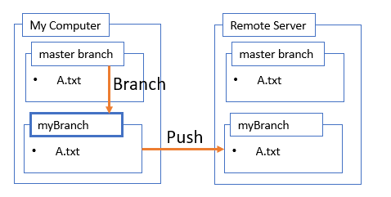
Create a Branch
git branch myBranch
git checkout myBranch
git push –u origin myBranch
Source: Michael Swart (http://michaeljswart.com/)

Slide 23
Change Stuff

Slide 24
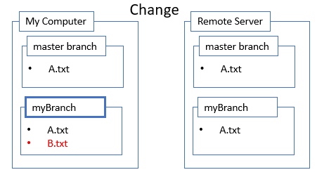
Make changes locally
Example: Add new file Step 1: Make changes
Source: Michael Swart (http://michaeljswart.com/)

Slide 25
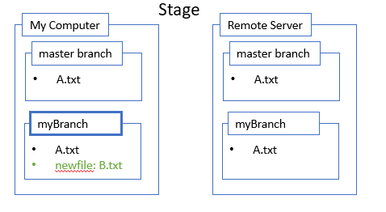
Make changes locally
Example: Add new file Step 1: Make changes
Step 2: Stage changes
git add *
Source: Michael Swart (http://michaeljswart.com/)

Slide 26
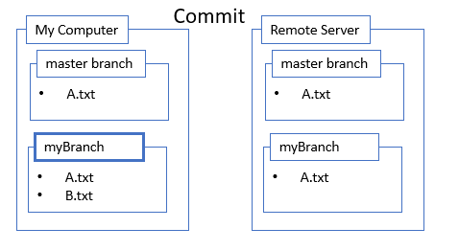
Make changes locally
Example: Add new file Step 1: Make changes
Step 2: Stage changes
Step 3: Commit changes
git commit –m “commit message”
Source: Michael Swart (http://michaeljswart.com/)
Notes:
One of the best pieces of advice that we've read was "you always have enough time to compose a meaningful commit message."
It's true. Please make your summary meaningful. Not necessarily long, just meaningful. We tend to add a description probably once every 20 commits if we can't sum up the commit well in the summary.

Slide 27
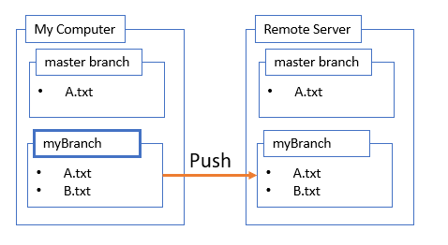
Make changes locally
Example: Add new file Step 1: Make changes
Step 2: Stage changes
Step 3: Commit changes
Step 4: Push changes
git push origin myBranch
Source: Michael Swart (http://michaeljswart.com/)

Slide 28
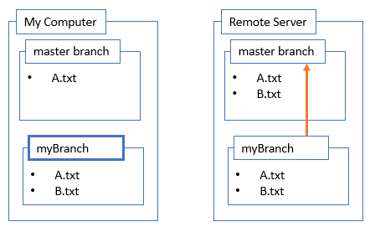
Make changes locally
Example: Add new file Step 1: Make changes
Step 2: Stage changes
Step 3: Commit changes
Step 4: Push changes
Step 5: Merge changes
git checkout master
git merge myBranch
Source: Michael Swart (http://michaeljswart.com/)
Notes:
git remote add upstream [url to the original repo]
git checkout [branch to be updated]
git fetch --all
git merge upstream/[branch to be updated]

Slide 29
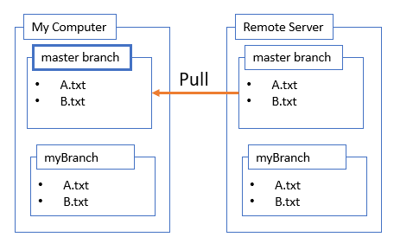
Making changes
Example: Add new file Step 1: Make changes
Step 2: Stage changes
Step 3: Commit changes
Step 4: Push changes
Step 5: Merge changes
Step 6: Pull changes
git pull
git checkout master
Source: Michael Swart (http://michaeljswart.com/)
Notes:
When you run the "pull" command, Git will:
Pull changes in the current branch made by other developers; and
Synchronize your local repository with the remote repository.
The "pull" command doesn't create a new directory with the project name. Git will only pull updates to make sure that your the local repository is up to date.
git branch –d myBranch

Slide 30
Pull Request

Slide 31
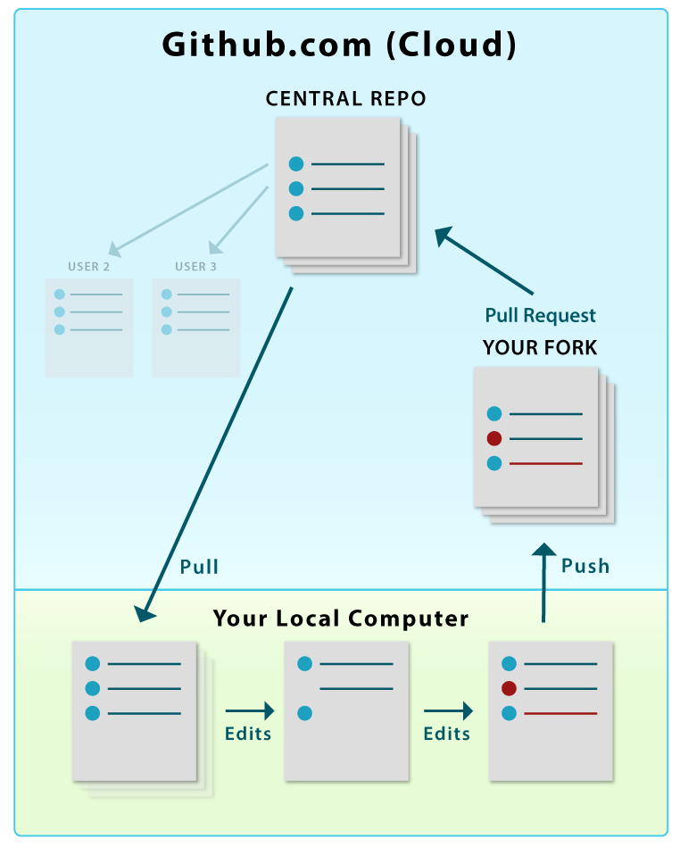
PULL REQUEST
Used to update original source
Syncs FORKED repository with source
Done via Github in Cloud

Slide 32
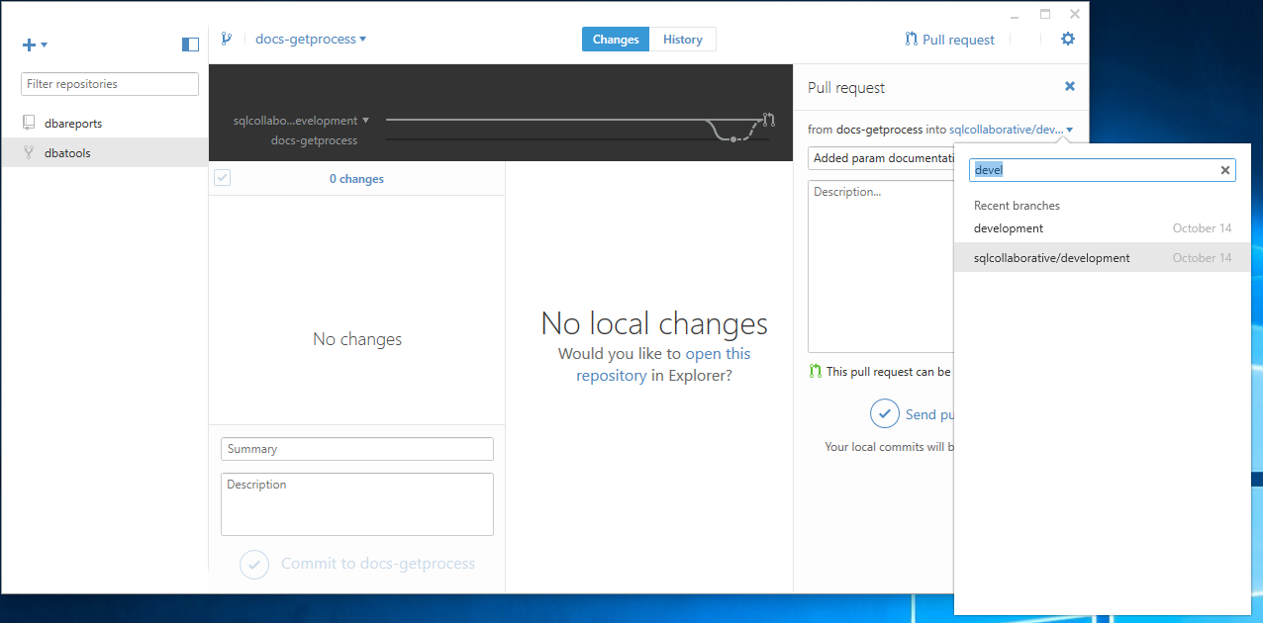

Slide 33
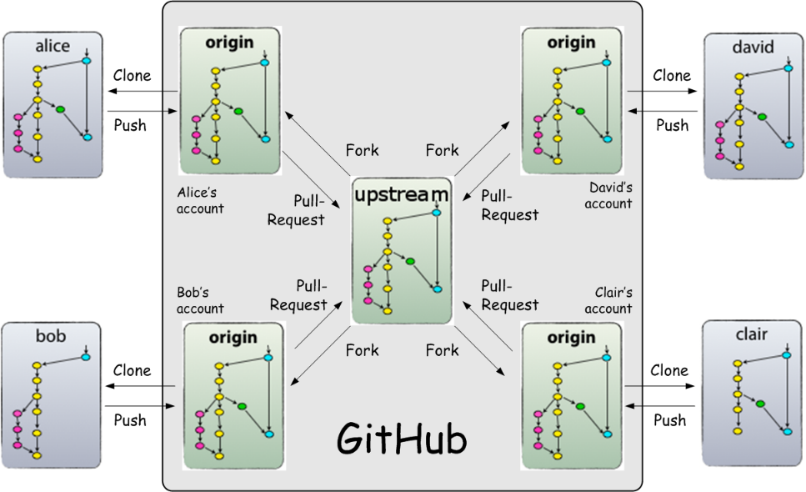

Slide 34


Notes:
Demo’s of Backup Script
Maintenance Plans Ola Hallengren
Minion Backup

Slide 35
Further Info
Notes:
Arose from need to evaluate
By Instance,

Slide 36
Other Useful Commands
git status
git remote –v
git branch –d myBranch
git checkout –b myBranch
git remote update
git fetch
git stash
Notes:
Contrary to the above comments, git pull and git fetch are not completely different commands. Rather, doing a git pull on a given branch is the same as doing a git fetch followed by either merging or rebasing the current branch on its remote counterpart which was just updated.
The utility of doing a git pull is that often the reason we fetch is to update a local branch with the version on the remote. So it is a bit of a convenience. We can always do fetch followed by merge separately.
git fetch –all same as git remote update
When you use pull, Git tries to automatically do your work for you. It is context sensitive, so Git will merge any pulled commits into the branch you are currently working in. pull automatically merges the commits without letting you review them first. If you don’t closely manage your branches, you may run into frequent conflicts.
When you fetch, Git gathers any commits from the target branch that do not exist in your current branch and stores them in your local repository. However, it does not merge them with your current branch. This is particularly useful if you need to keep your repository up to date, but are working on something that might break if you update your files. To integrate the commits into your master branch, you use merge.

Slide 37
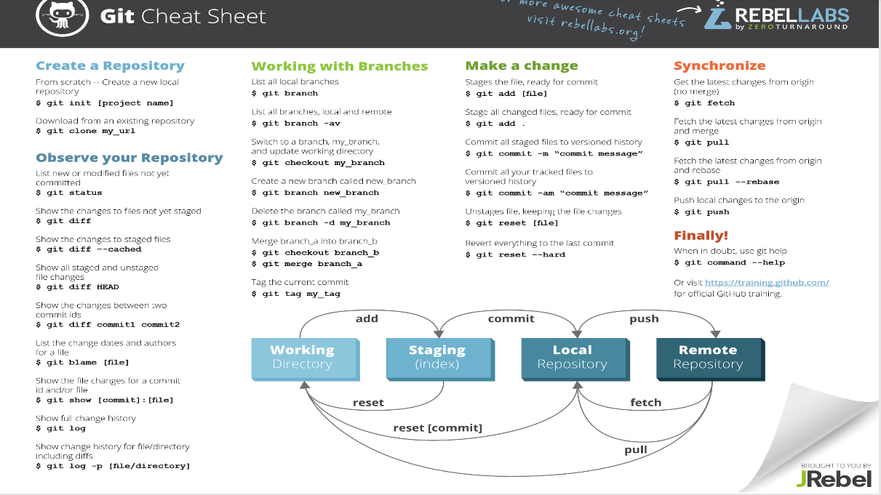

Slide 38
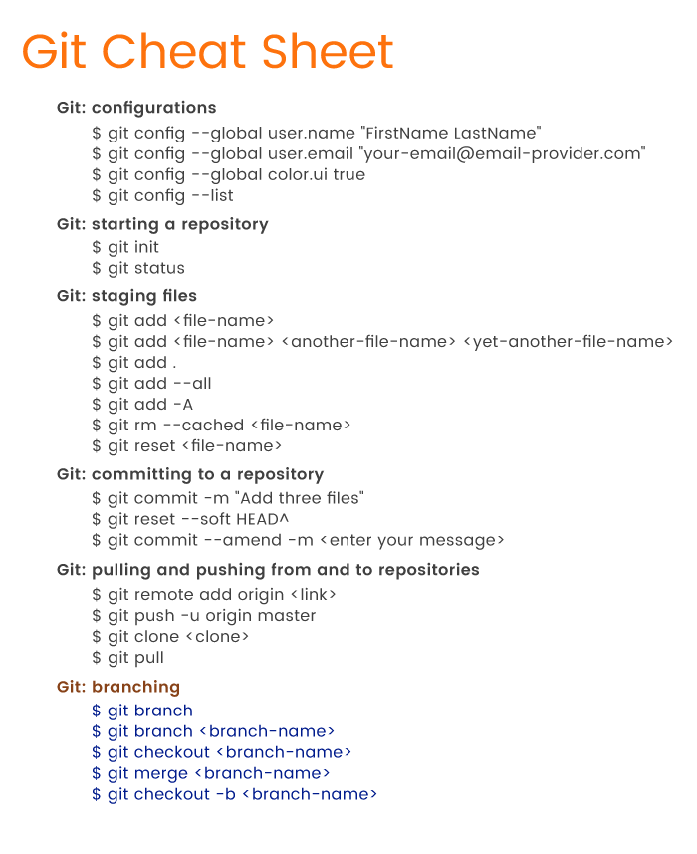
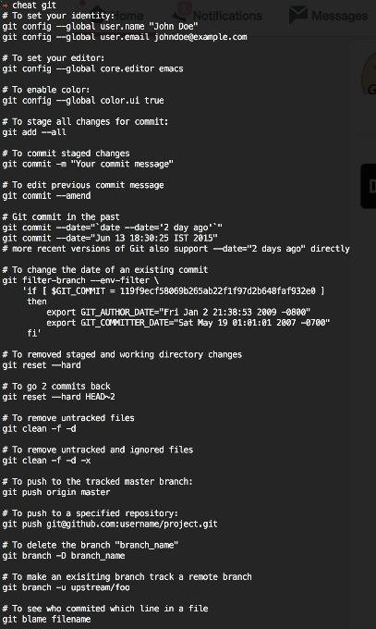

Slide 39

Free Online
https://git-scm.com/book/en/v2

Slide 40
Cleanup
Notes:
Options if you want to reset changes or delete forked repository

Slide 41
Reset a Forked Repository
# Check Remote Status
git remote -v
# Fetch Files
git fetch upstream
git status
# Switch to main branch (if not already)
git checkout development
git reset --hard upstream/development
git push origin development --force
git status
https://stackoverflow.com/questions/9646167/clean-up-a-fork-and-restart-it-from-the-upstream

Slide 42
Delete a Forked Repository in GitHub
On GitHub, navigate to the main page of the repository.
Under your repository name, click Settings.
Under Danger Zone, click Delete this repository.
Read the warnings.
To verify that you're deleting the correct repository, type the name of the repository you want to delete.
Click I understand the consequences, delete this repository.

Slide 43
Notes:
Demo’s of Backup Script
Maintenance Plans Ola Hallengren
Minion Backup

Slide 44
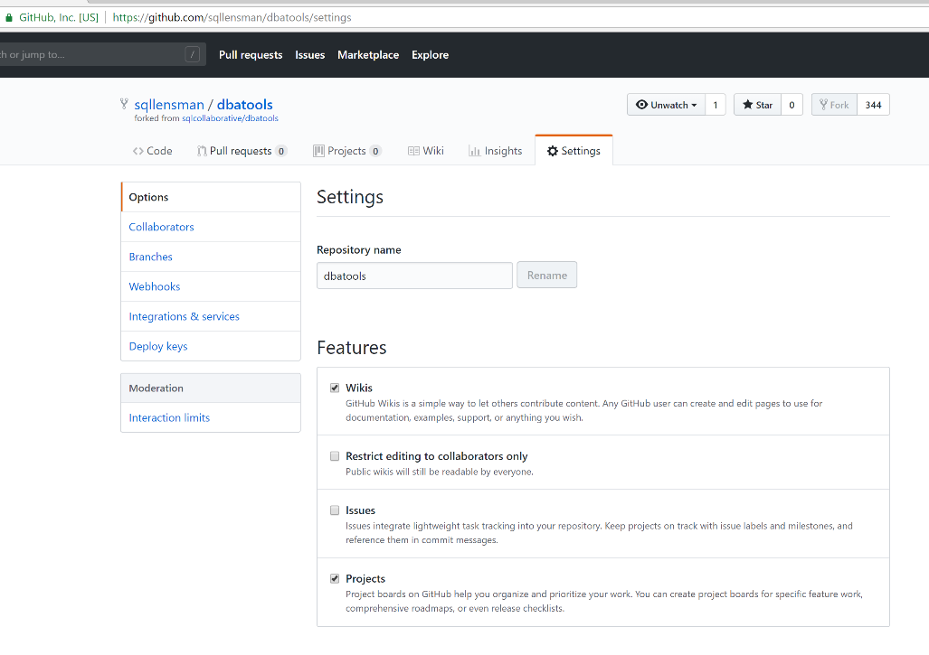

Slide 45
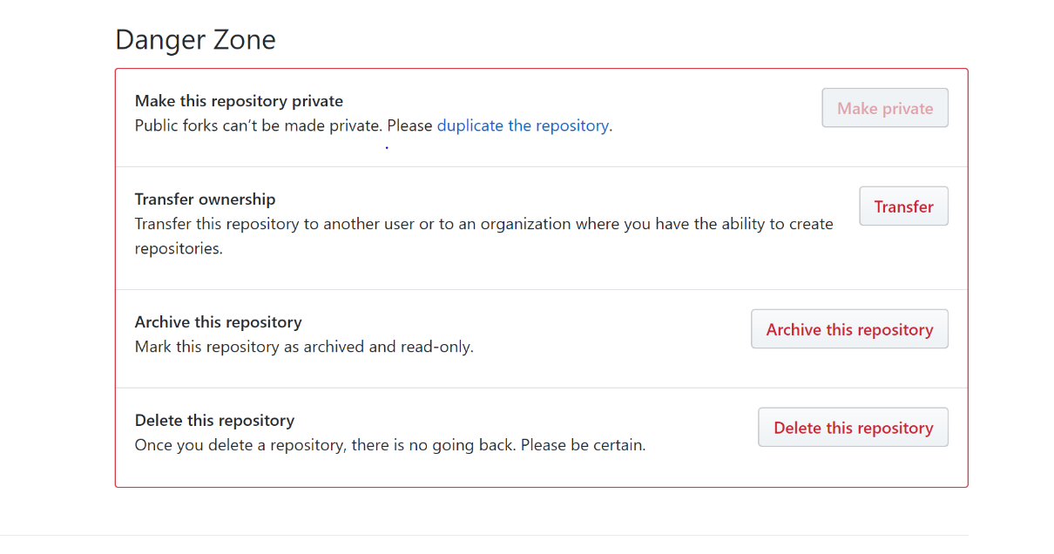

Slide 46
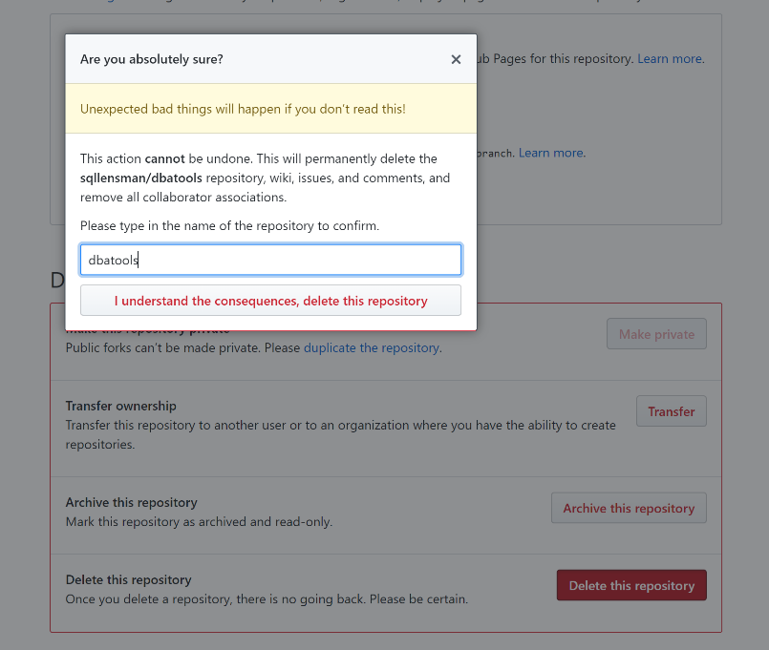

Slide 47
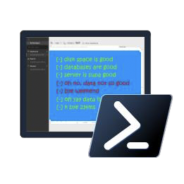
Questions

Slide 48
Links
https://git-scm.com
http://www.eqqon.com/index.php/Collaborative_Github_Workflow
https://zeroturnaround.com/rebellabs/git-commands-and-best-practices-cheat-sheet/
https://medium.freecodecamp.org/git-cheat-sheet-and-best-practices-c6ce5321f52
https://github.com/git-tips/tips
https://blog.github.com/2015-06-08-how-to-undo-almost-anything-with-git/
https://rubygarage.org/blog/most-basic-git-commands-with-examples
http://michaeljswart.com/2018/07/the-bare-minimum-you-need-to-know-to-work-with-git/
https://www.ibm.com/developerworks/library/d-learn-workings-git/
http://www.differencebetween.net/technology/difference-between-git-fetch-and-git-pull/
https://www.git-tower.com/learn/git/faq
https://www.git-tower.com/learn/git/ebook/en/command-line/introduction
https://www.git-tower.com/learn/git/ebook/en/desktop-gui/introduction
https://www.pass.org/AttendanEvent/OnlineEvents/24HoursofPASS.aspx
Lyndsey Padget Presentation on GIT
VSCode https://marketplace.visualstudio.com/items?itemName=eamodio.gitlens

Slide 49
Social
Make sure you tweet on #SQLSat746 or #SQLSatOslo
Don’t forget to thank Volunteers and other Speakers!

Slide 50
Thank you for attending #SQLSATOslo

